Slide 1



HR Data Analysis
View in Power BI
Last data refresh:
3/7/2022 1:25:40 PM UTC
Downloaded at:
3/7/2022 1:44:30 PM UTC

Slide 2
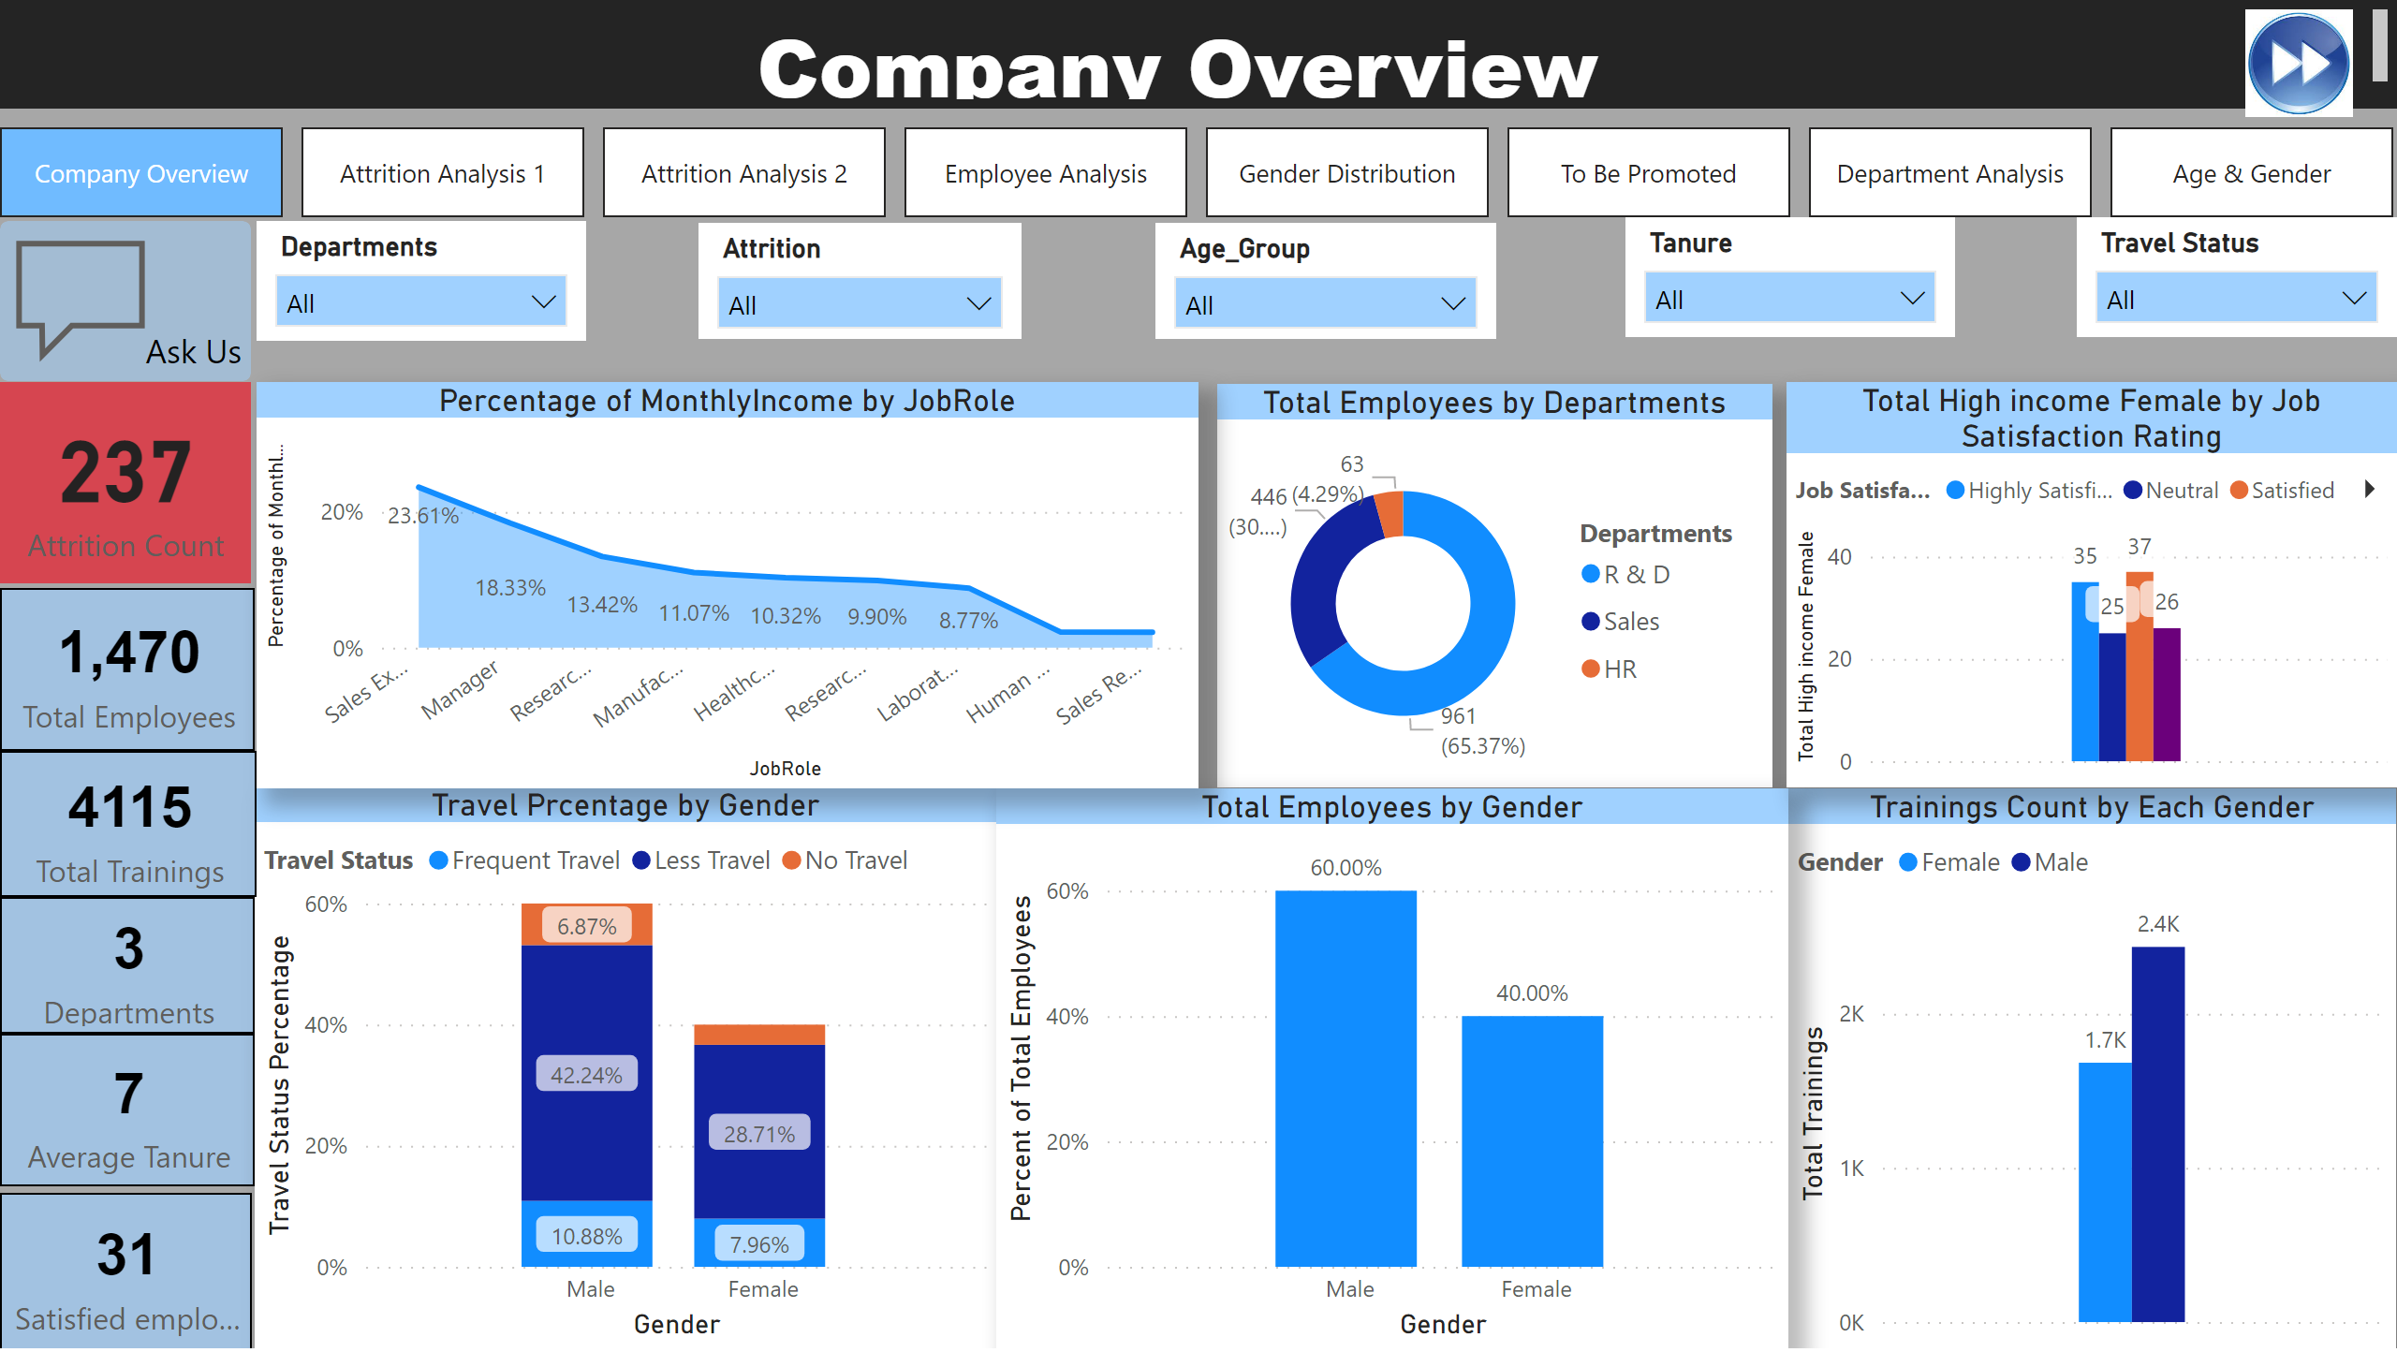
Company Overview
Notes:
card
No alt text provided
card
No alt text provided
textbox
No alt text provided
Travel Prcentage by Gender
No alt text provided
pageNavigator
No alt text provided
actionButton
No alt text provided
Trainings Count by Each Gender
No alt text provided
Total Employees by Departments
No alt text provided
Total Employees by Gender
No alt text provided
lineClusteredColumnComboChart
No alt text provided
stackedAreaChart
No alt text provided
card
No alt text provided
slicer
No alt text provided
slicer
No alt text provided
slicer
No alt text provided
slicer
No alt text provided
slicer
No alt text provided
image
No alt text provided
Total Departments
No alt text provided
card
No alt text provided
Satisfaction Percent
No alt text provided

Slide 3
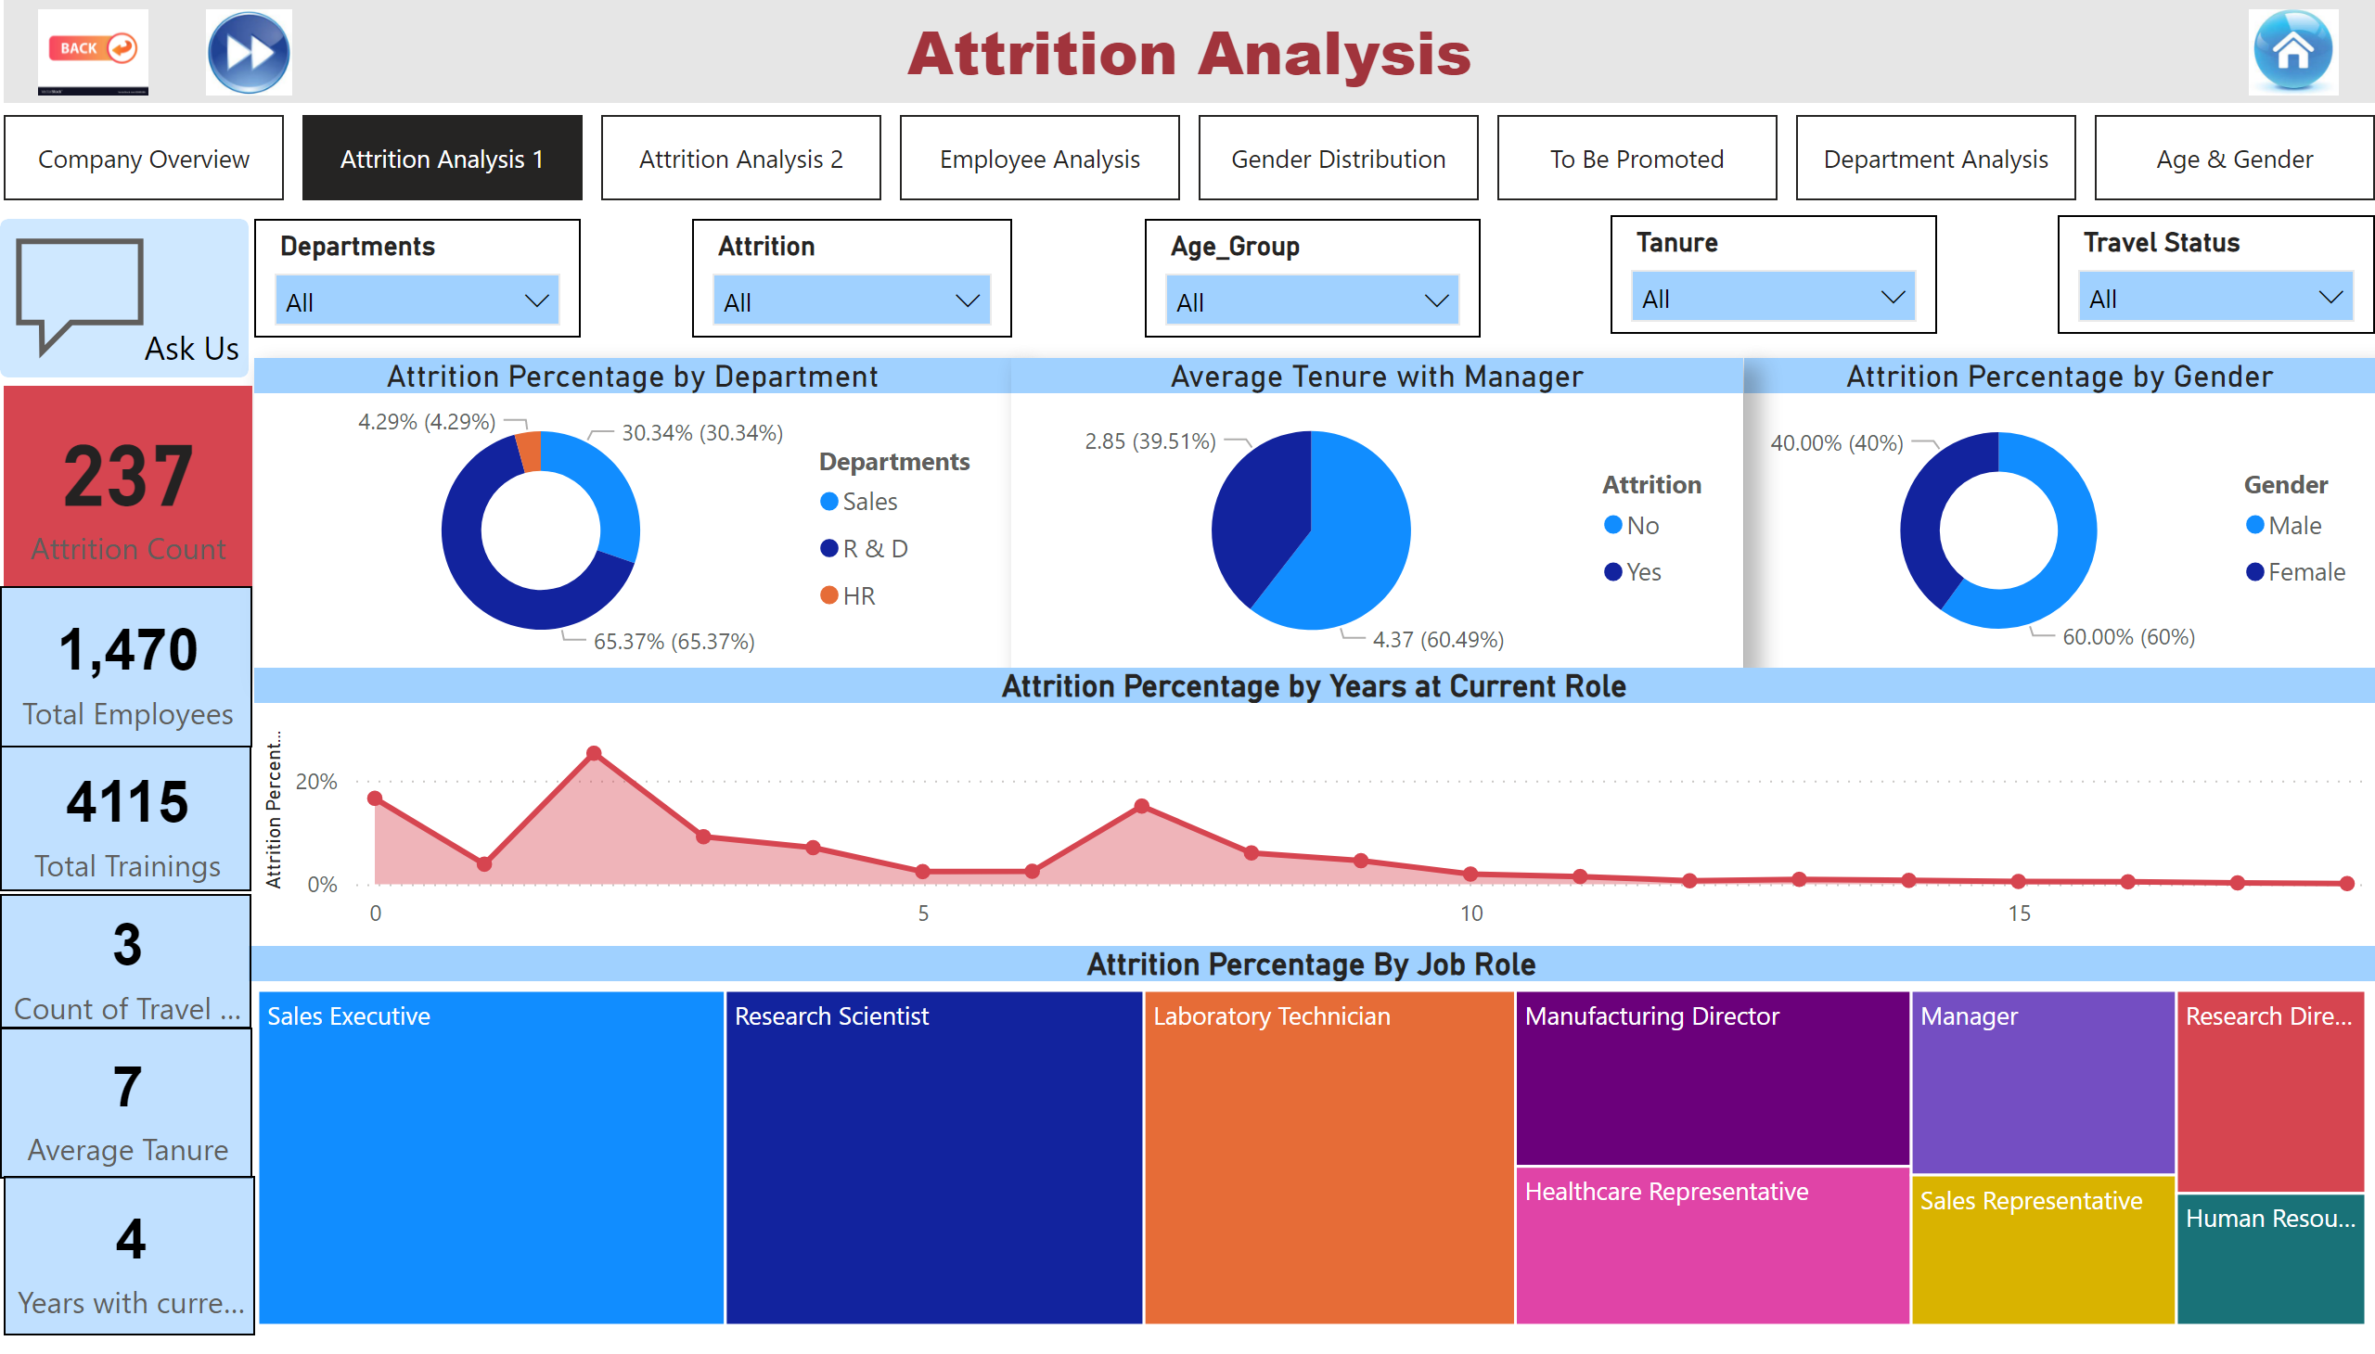
Attrition Analysis 1
Notes:
slicer
No alt text provided
slicer
No alt text provided
slicer
No alt text provided
slicer
No alt text provided
slicer
No alt text provided
textbox
No alt text provided
pageNavigator
No alt text provided
actionButton
No alt text provided
image
No alt text provided
image
No alt text provided
card
No alt text provided
card
No alt text provided
card
No alt text provided
card
No alt text provided
areaChart
No alt text provided
donutChart
No alt text provided
Total Departments
No alt text provided
Attrition Percentage by Department
No alt text provided
Average Tenure with Manager
No alt text provided
Attrition Percentage By Job Role
No alt text provided
card
No alt text provided
image
No alt text provided

Slide 4
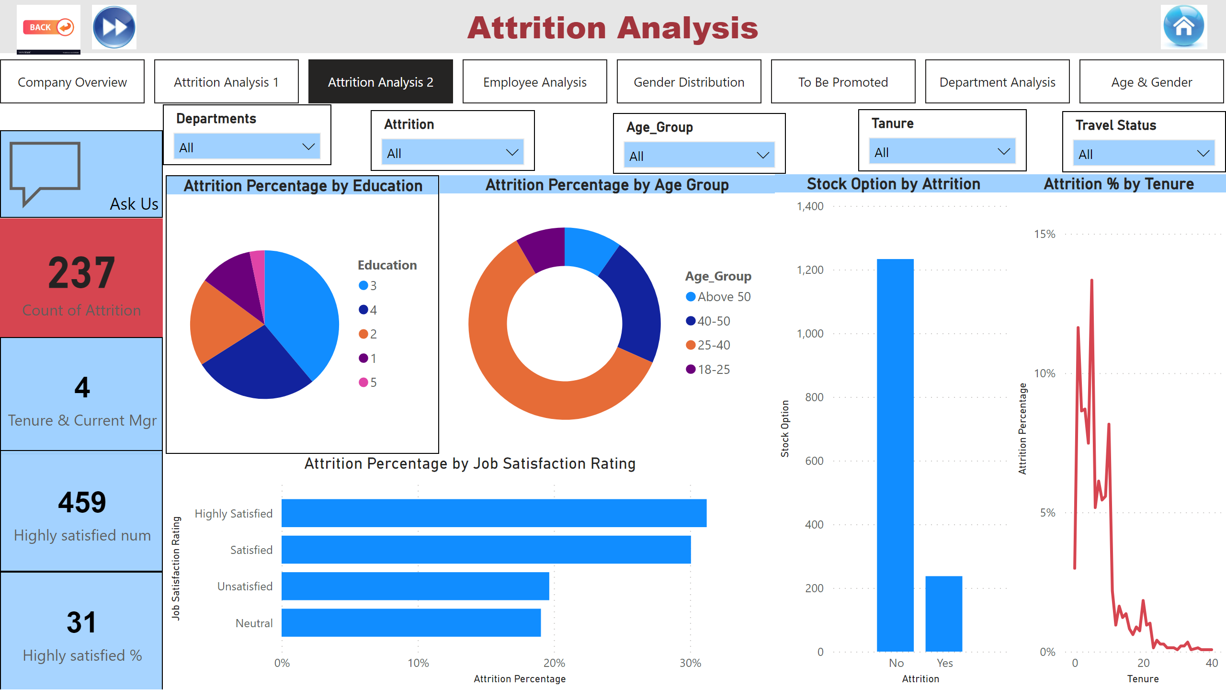
Attrition Analysis 2
Notes:
textbox
No alt text provided
pageNavigator
No alt text provided
slicer
No alt text provided
slicer
No alt text provided
slicer
No alt text provided
slicer
No alt text provided
slicer
No alt text provided
actionButton
No alt text provided
image
No alt text provided
image
No alt text provided
image
No alt text provided
card
No alt text provided
Satisfaction Percent
No alt text provided
card
No alt text provided
Attrition % by Tenure
No alt text provided
Attrition Percentage by Age Group
No alt text provided
card
No alt text provided
clusteredColumnChart
No alt text provided
barChart
No alt text provided
pieChart
No alt text provided

Slide 5
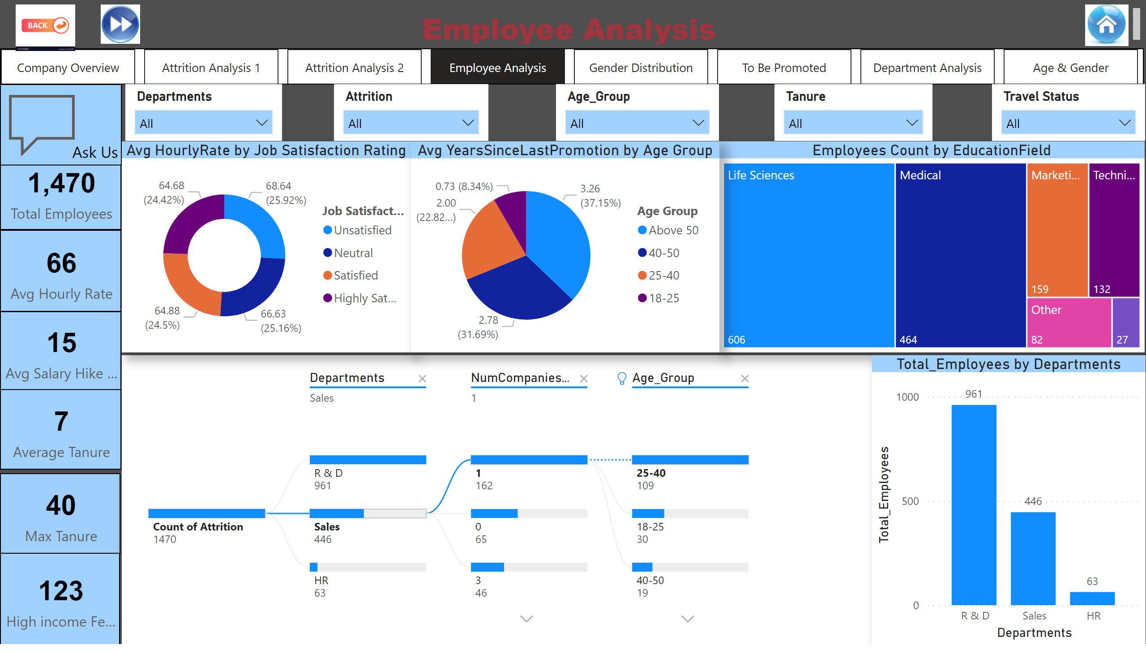
Employee Analysis
Notes:
textbox
No alt text provided
pageNavigator
No alt text provided
slicer
No alt text provided
slicer
No alt text provided
slicer
No alt text provided
slicer
No alt text provided
slicer
No alt text provided
image
No alt text provided
image
No alt text provided
image
No alt text provided
actionButton
No alt text provided
actionButton
No alt text provided
card
No alt text provided
card
No alt text provided
card
No alt text provided
Employees Count by EducationField
No alt text provided
donutChart
No alt text provided
clusteredColumnChart
No alt text provided
card
No alt text provided
card
No alt text provided
card
No alt text provided
pieChart
No alt text provided
decompositionTreeVisual
No alt text provided

Slide 6
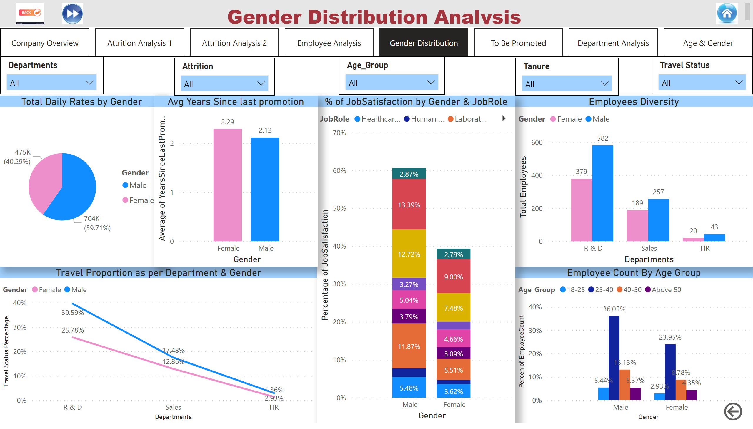
Gender Distribution
Notes:
textbox
No alt text provided
actionButton
No alt text provided
slicer
No alt text provided
slicer
No alt text provided
slicer
No alt text provided
slicer
No alt text provided
Employee Count By Age Group
No alt text provided
Employees Diversity
No alt text provided
Travel Proportion as per Department & Gender
No alt text provided
Avg Years Since last promotion
No alt text provided
% of JobSatisfaction by Gender & JobRole
No alt text provided
pieChart
No alt text provided
slicer
No alt text provided
pageNavigator
No alt text provided
image
No alt text provided
image
No alt text provided
image
No alt text provided

Slide 7
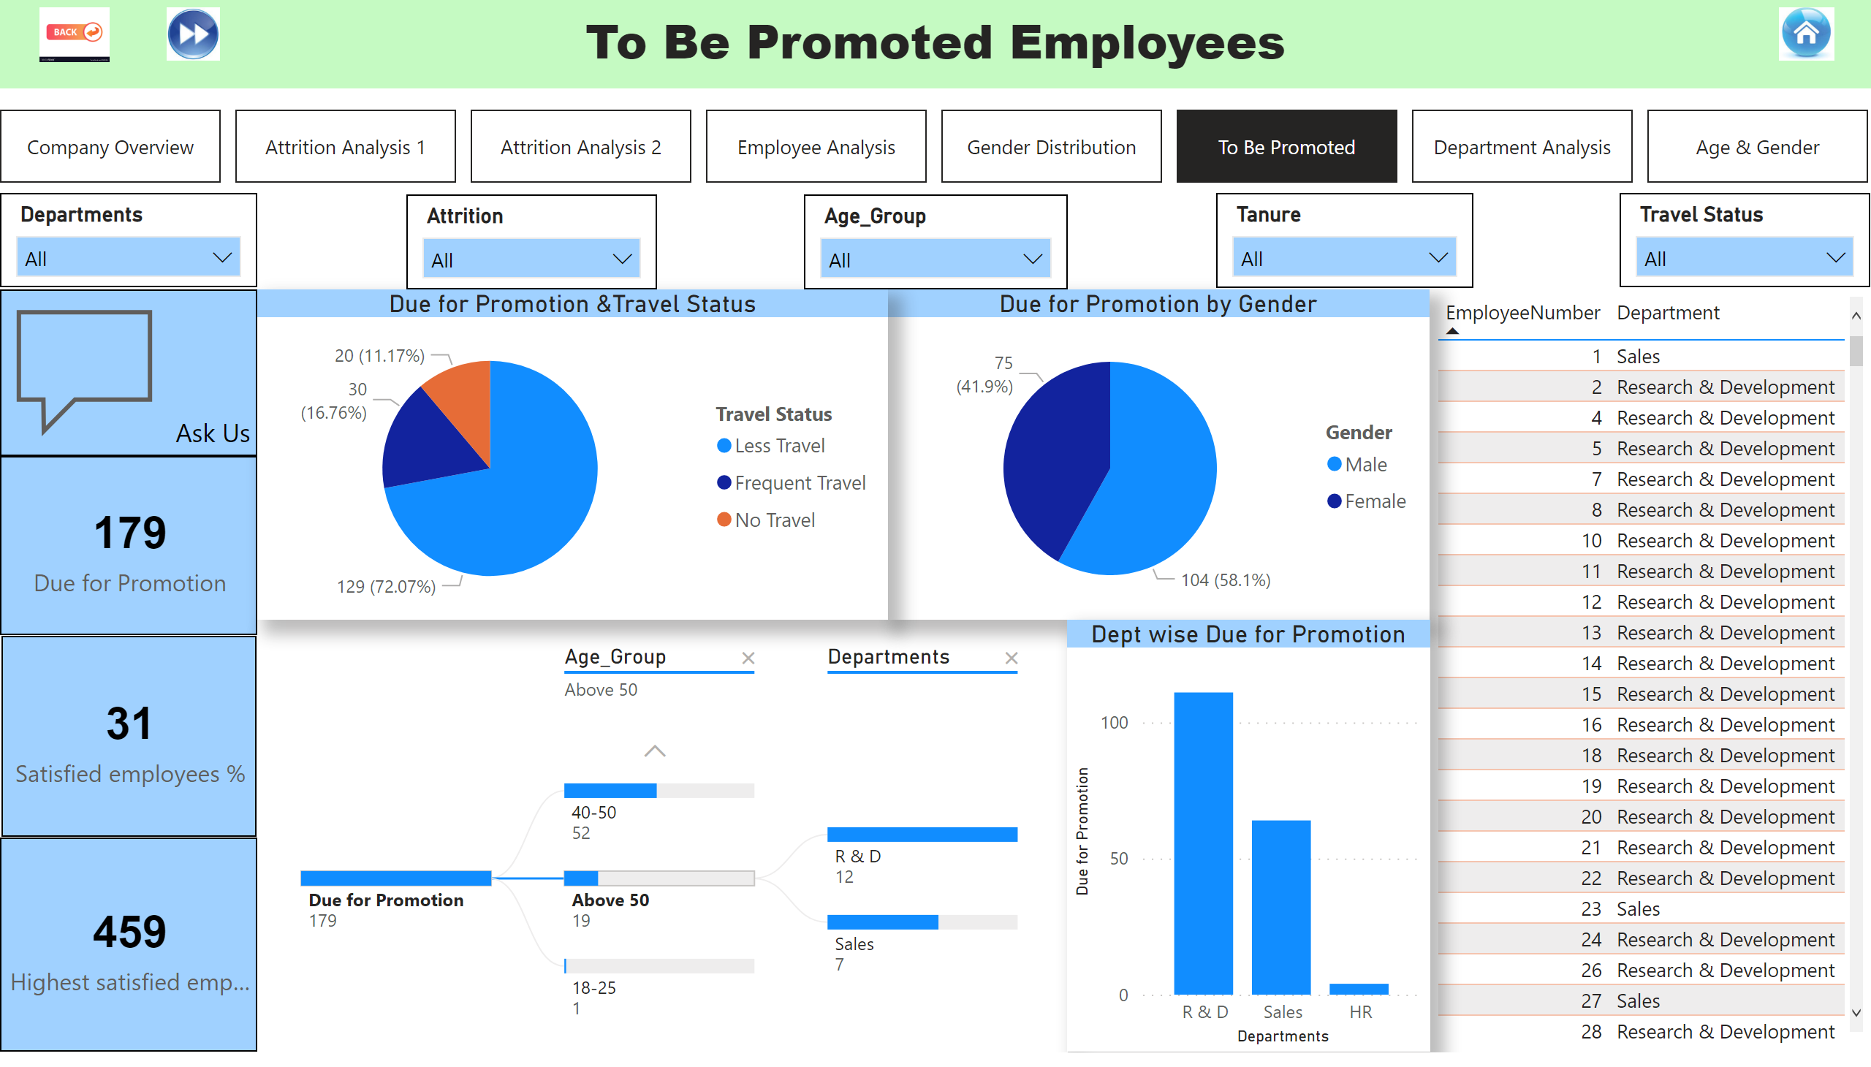
To Be Promoted
Notes:
image
No alt text provided
image
No alt text provided
image
No alt text provided
pageNavigator
No alt text provided
slicer
No alt text provided
slicer
No alt text provided
slicer
No alt text provided
slicer
No alt text provided
slicer
No alt text provided
actionButton
No alt text provided
textbox
No alt text provided
Satisfaction Percent
No alt text provided
card
No alt text provided
Due for Promotion &Travel Status
No alt text provided
tableEx
No alt text provided
Dept wise Due for Promotion
No alt text provided
Satisfaction Percent
No alt text provided
decompositionTreeVisual
No alt text provided
pieChart
No alt text provided

Slide 8
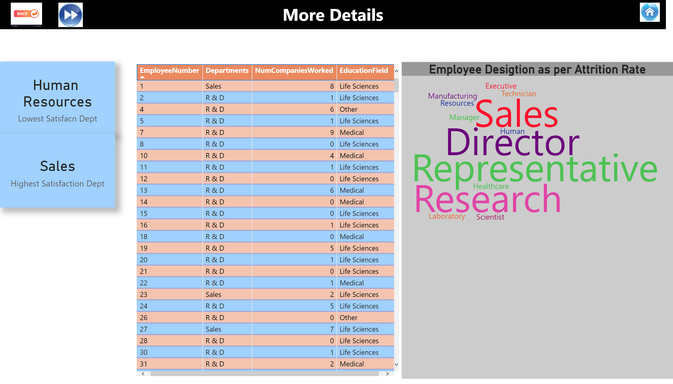
Department Analysis
Notes:
image
No alt text provided
textbox
No alt text provided
image
No alt text provided
image
No alt text provided
card
No alt text provided
card
No alt text provided
tableEx
No alt text provided
Employee Desigtion as per Attrition Rate
No alt text provided

Slide 9
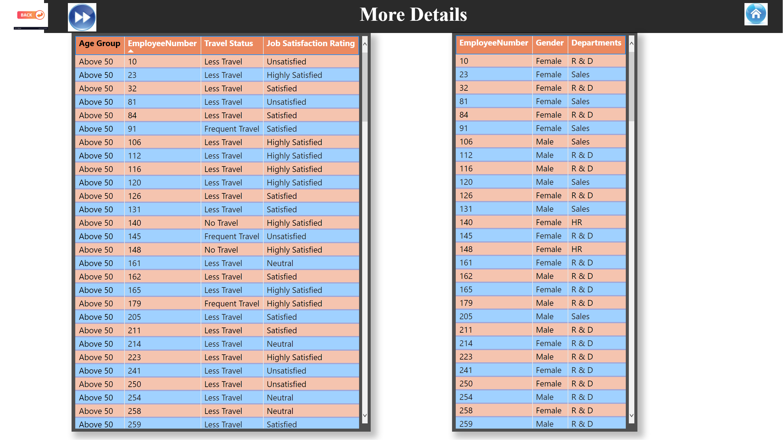
Age & Gender
Notes:
textbox
No alt text provided
image
No alt text provided
image
No alt text provided
image
No alt text provided
tableEx
No alt text provided
tableEx
No alt text provided

